Slide 1
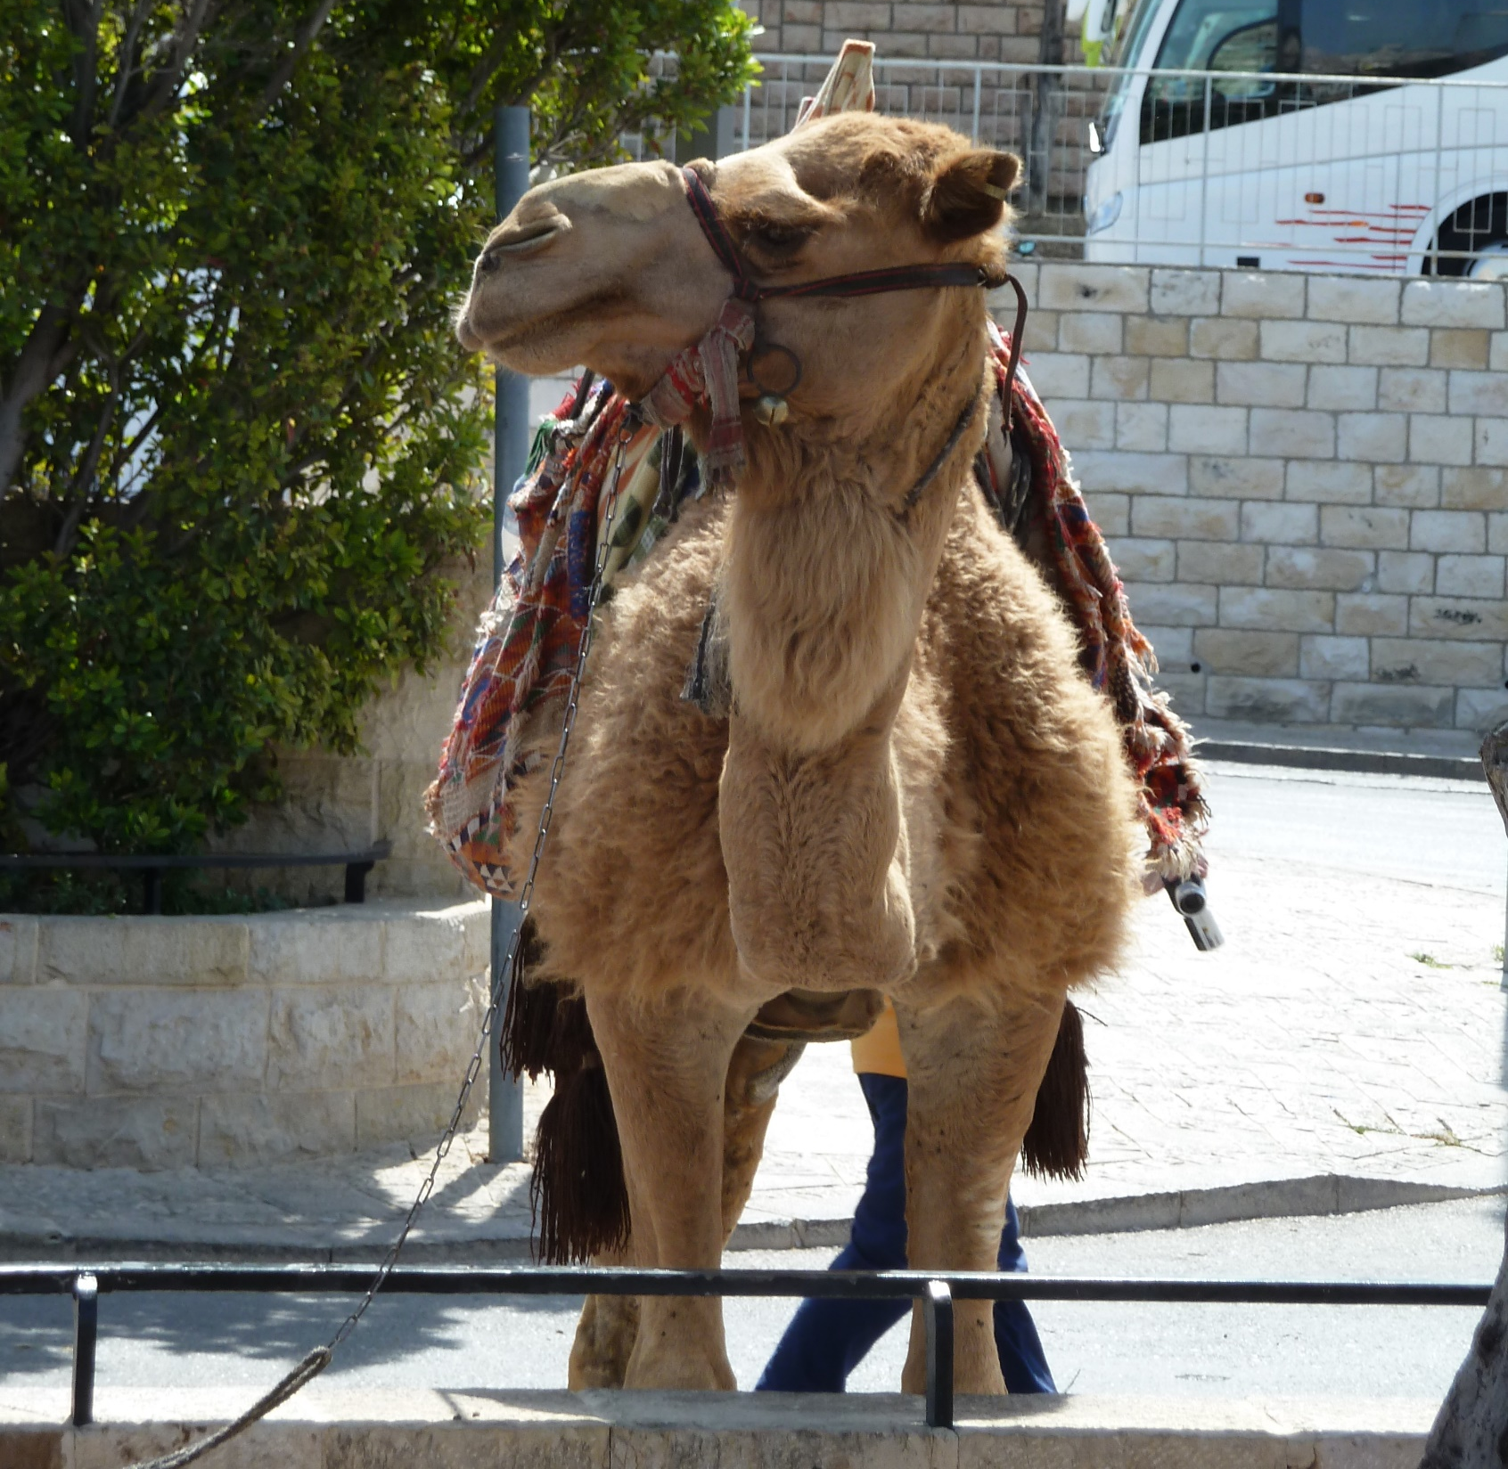
John 18.28-38

Slide 2
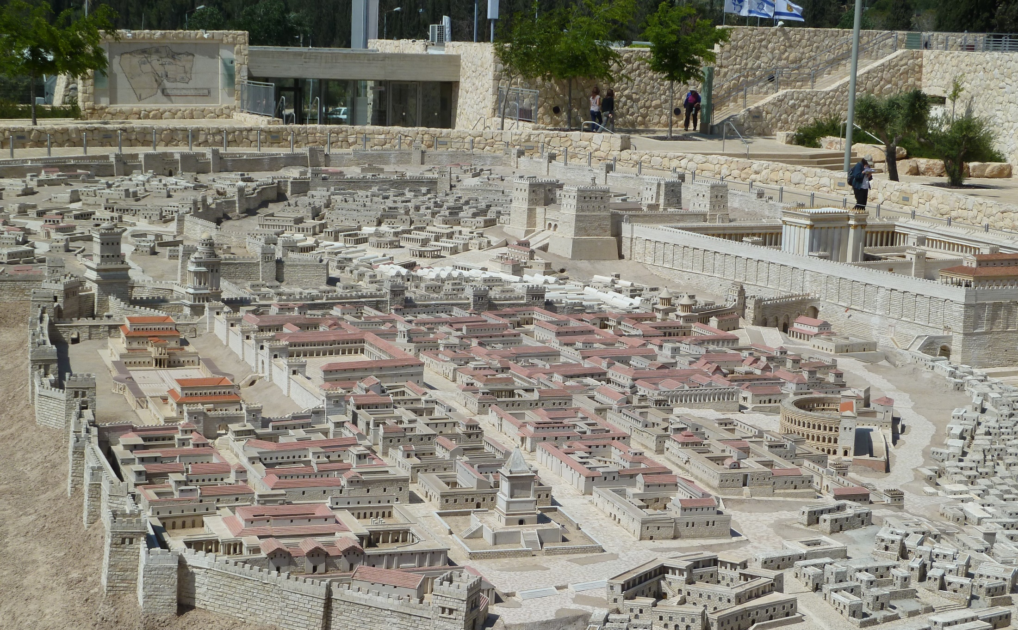
John 18.28 NET: Then they brought Jesus from Caiaphas to the Roman governor's residence. (Now it was very early morning.) They did not go into the governor's residence so they would not be ceremonially defiled, but could eat the Passover meal.

Slide 3
John 18.28 NET: Then they brought Jesus from Caiaphas to the Roman governor's residence. (Now it was very early morning.) They did not go into the governor's residence so they would not be ceremonially defiled, but could eat the Passover meal.

Slide 4
Original Passover: sacrifice an unblemished lamb for deliverance to physical life.
Passover celebration: sacrifice an unblemished lamb to remember God’s deliverance in the Exodus and anticipate deliverance through the Messiah.
Crucifixion: sacrifice the ultimate unblemished Passover lamb for deliverance to spiritual and resurrection life.

Slide 5
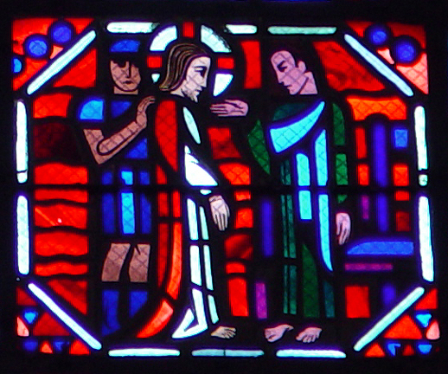
John 18.29-30: So Pilate came outside to them and said, “What accusation do you bring against this man?” They replied, “If this man were not a criminal, we would not have handed him over to you.”
Art by LeBreton and Gaudin; courtesy of vanderbuilt.edu

Slide 6
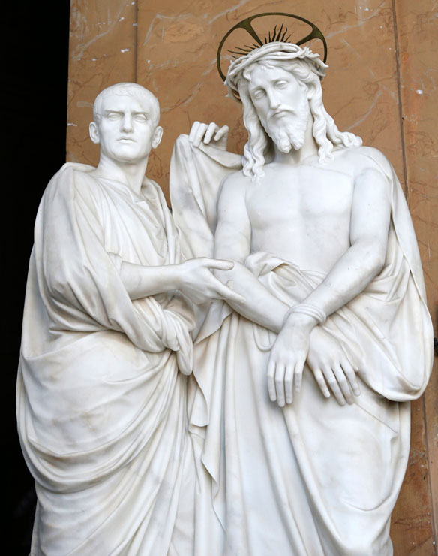
John 18.31-32: Pilate told them, “Take him yourselves and pass judgment on him according to your own law!”
The Jewish leaders replied, “We cannot legally put anyone to death.”
(This happened to fulfill the word Jesus had spoken when he indicated what kind of death he was going to die.)
image from christianwikipedia.com

Slide 7
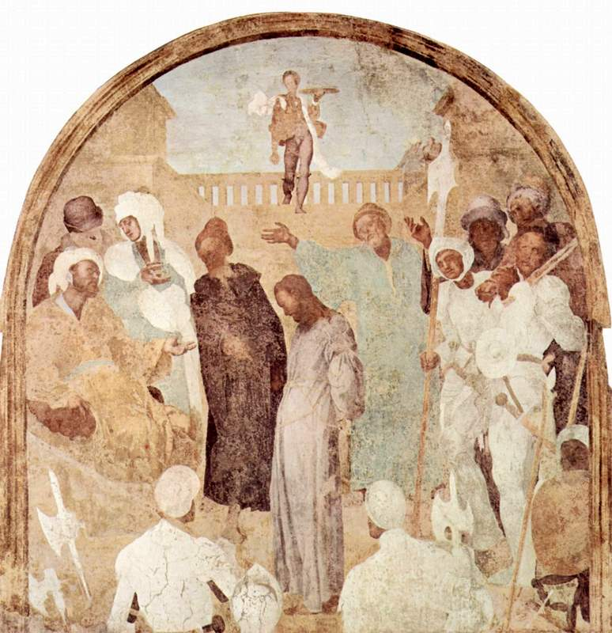
John 18.33: So Pilate went back into the governor's residence, summoned Jesus, and asked him, “Are you the king of the Jews?”
painting by Pontormo; courtesy of Vanderbilt.edu

Slide 8
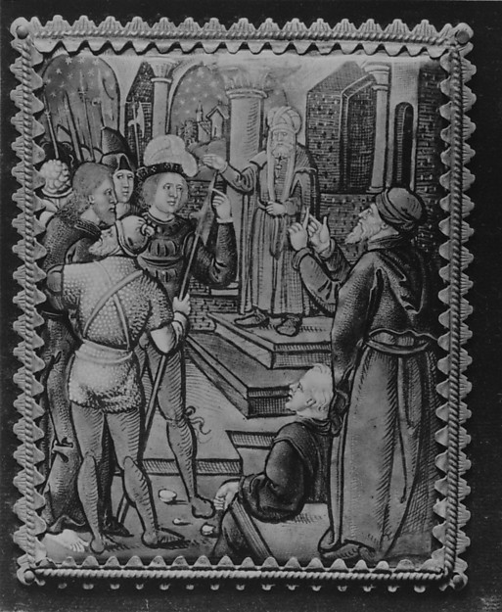
John 18.34-35: Jesus replied, “Are you saying this on your own initiative, or have others told you about me?” Pilate answered, “I am not a Jew, am I? Your own people and your chief priests handed you over to me. What have you done?”
Fletcher Fund; metmuseum.org

Slide 9
John 18.36: Jesus replied, “My kingdom is not from this world. If my kingdom were from this world, my servants would be fighting to keep me from being handed over to the Jewish authorities. But as it is, my kingdom is not from here.”
Worldly Messianic
created eternal/transcendent
fallen/rebellious righteous/representative
sinful violence love/truth/grace

Slide 10
John 18.37-38: Then Pilate said, “So you are a king!"
Jesus replied, “You say that I am a king. For this reason I was born, and for this reason I came into the world– to testify to the truth. Everyone who belongs to the truth listens to my voice.”
Pilate asked, “What is truth?”
When he had said this he went back outside to the Jewish leaders and announced, “I find no basis for an accusation against him.”

